Slide 1
Masanori Uno

Slide 2
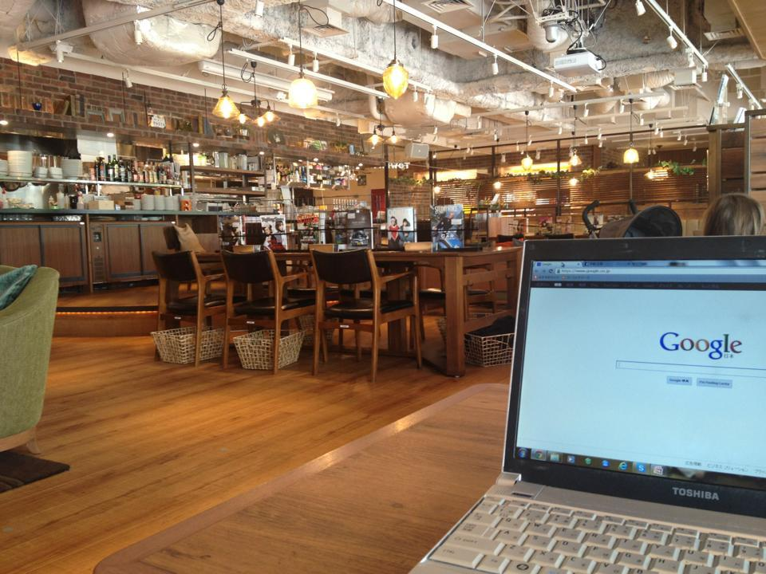
What do I do on a holiday?
Traveling to various cities
Learning new developing skill by myself
and so on..

Slide 3


How can I help you?
First semester at ReDI
Software Developer
Develop web application, mainly
Python, Flask and so on..

Slide 4
How can you contact me?
Slack:
Email: masanoriuno@gmail.com

